Slide 1
Gopi’s Kitchen Story
Web Project

Slide 2
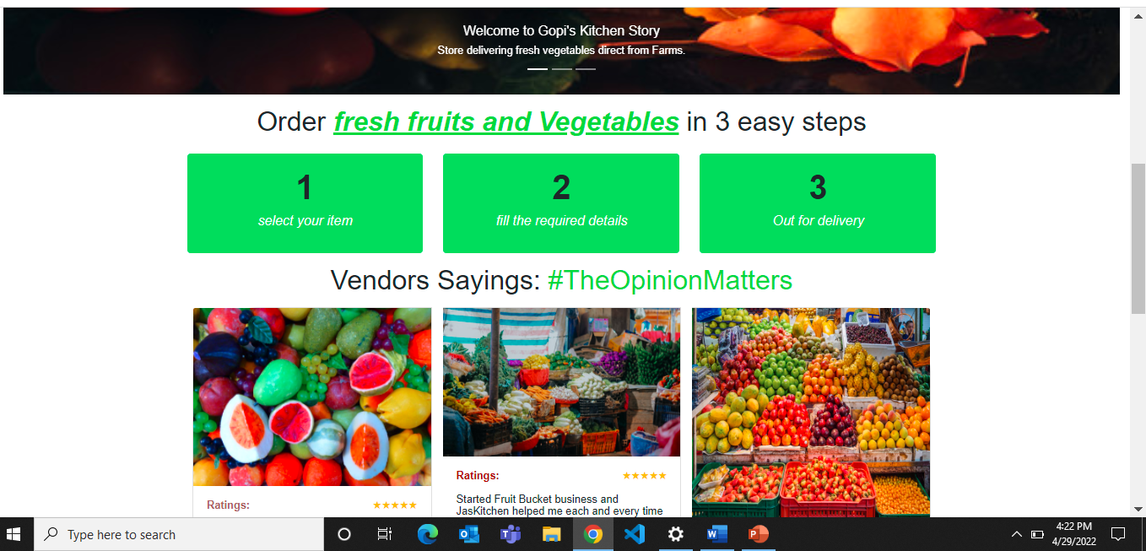
Home Page

Slide 3
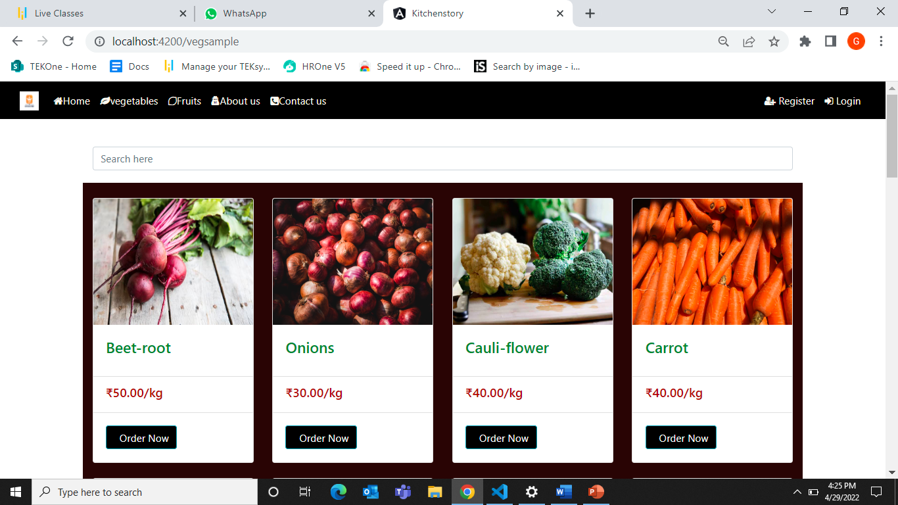
VegetablES

Slide 4
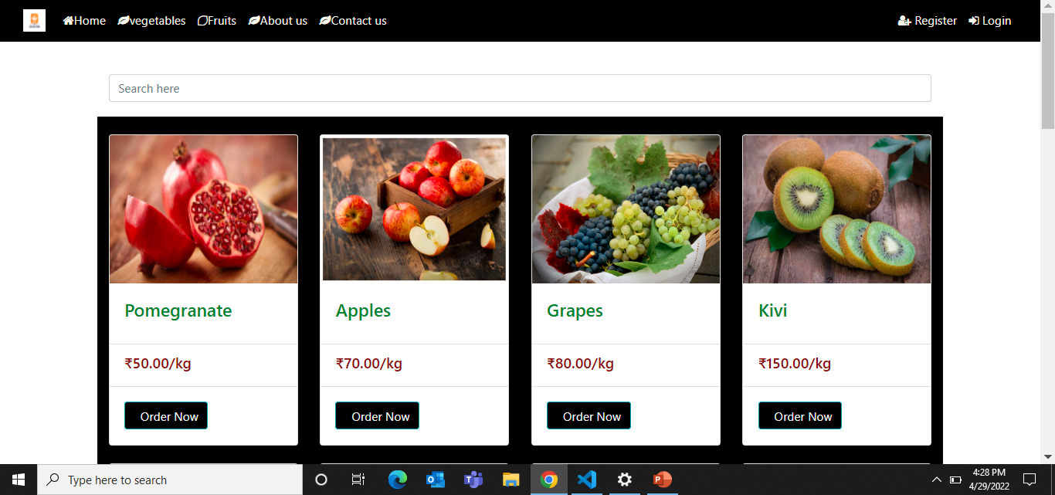
Fruits

Slide 5
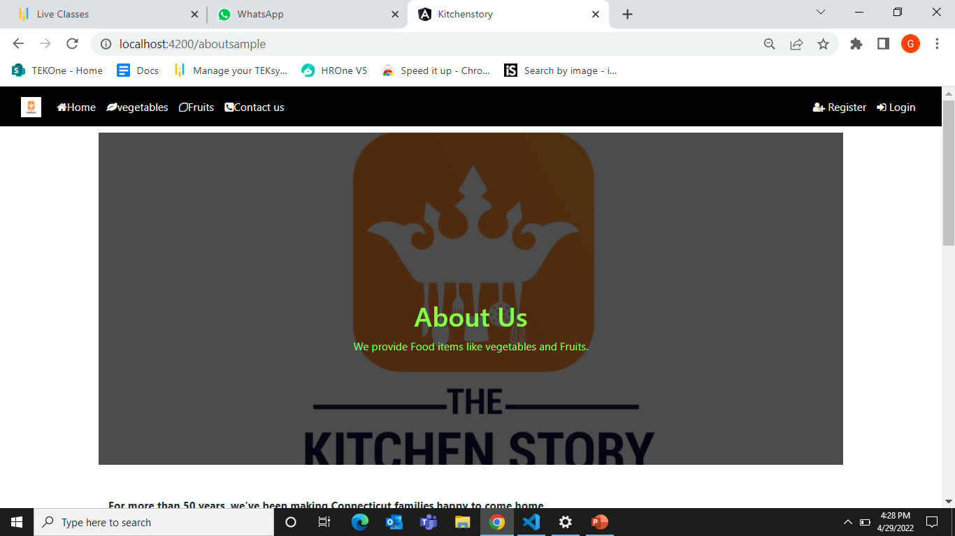
ABOUT Us

Slide 6
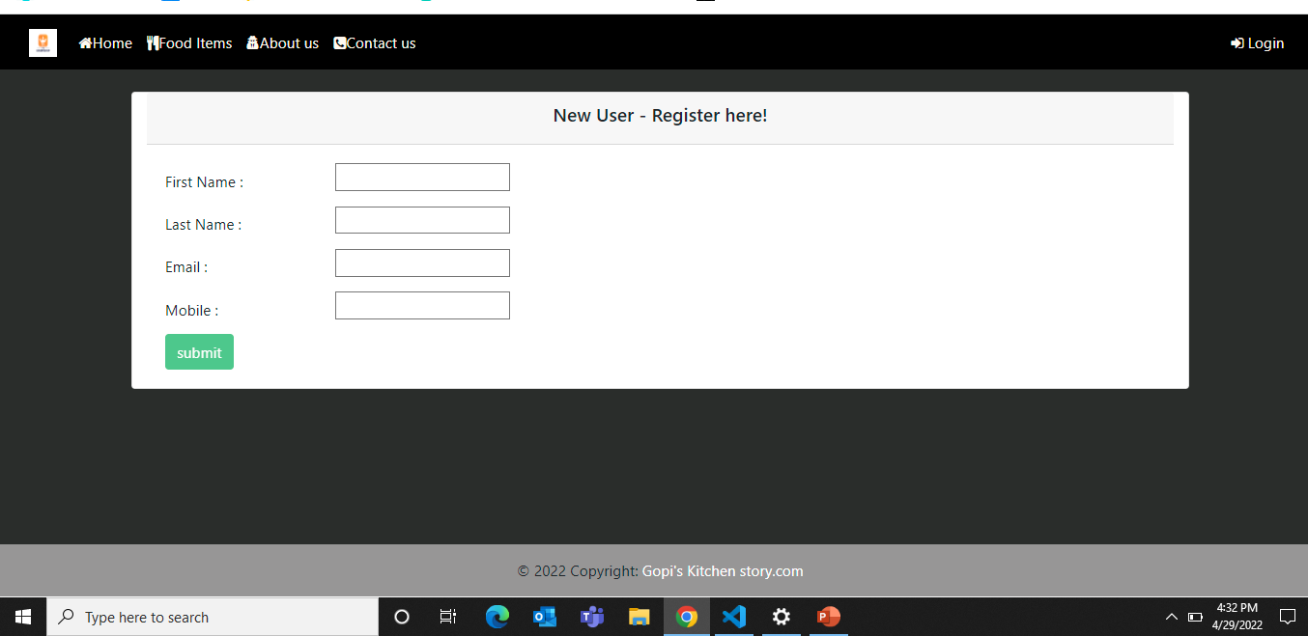
Register page

Slide 7
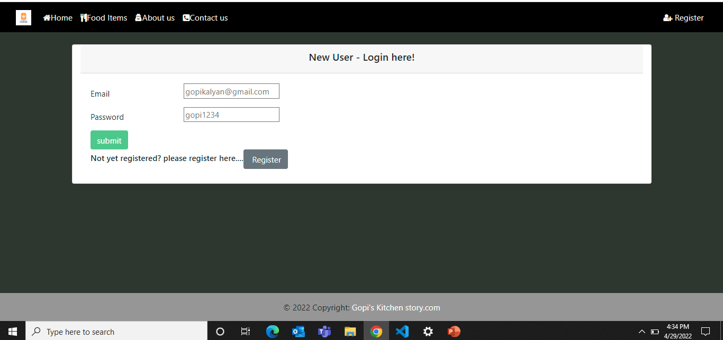
Login Page

Slide 8
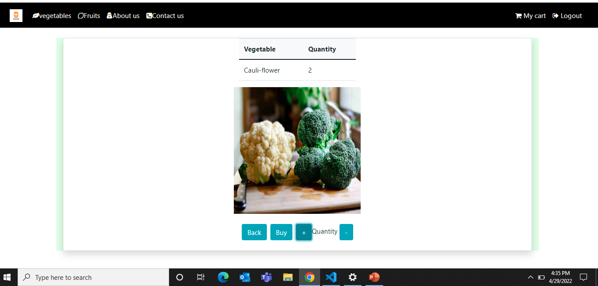
Kitchen Page

Slide 9
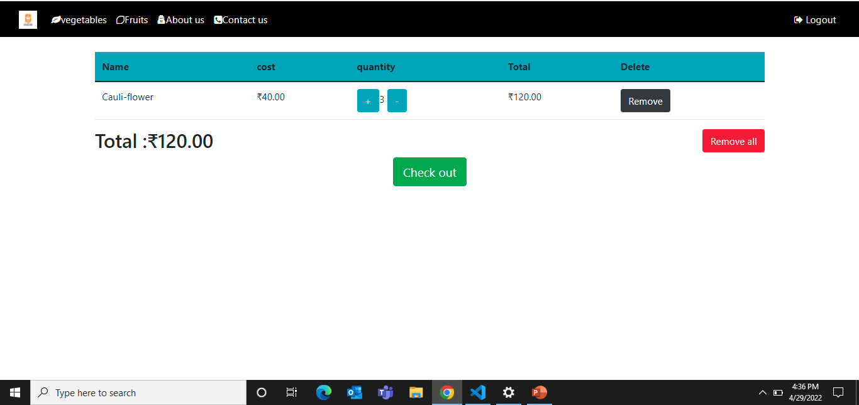
CART

Slide 10
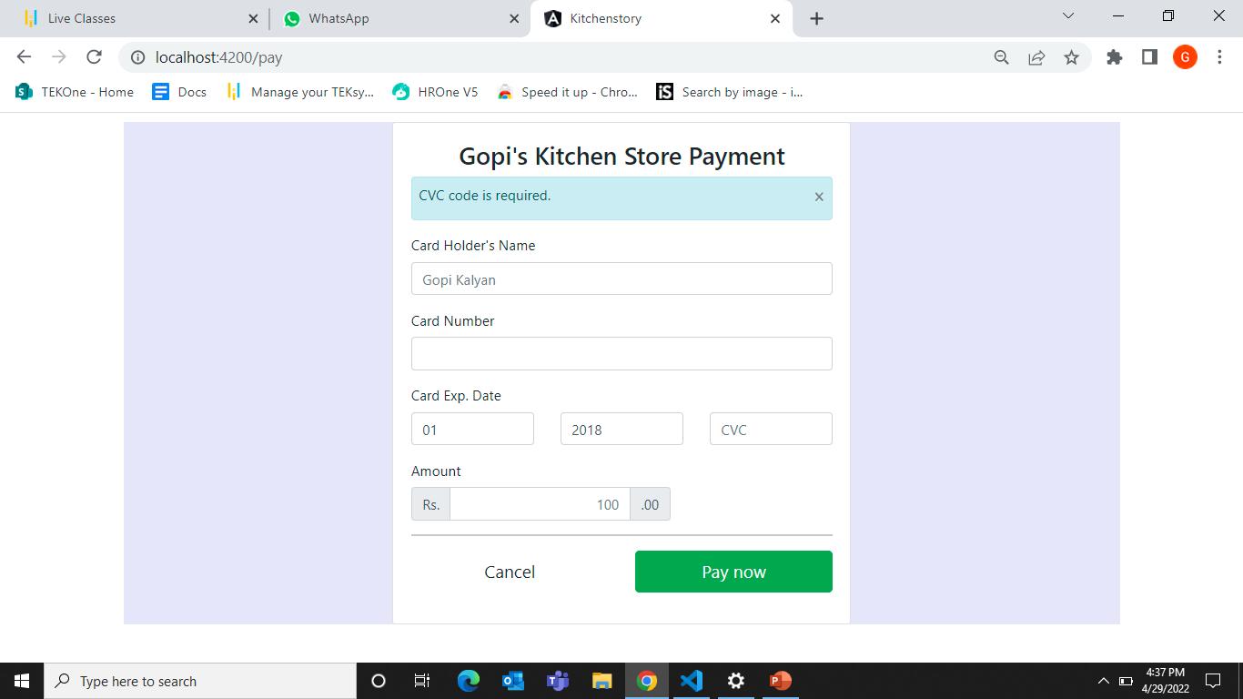
Pay/BUY pAGE

Slide 11
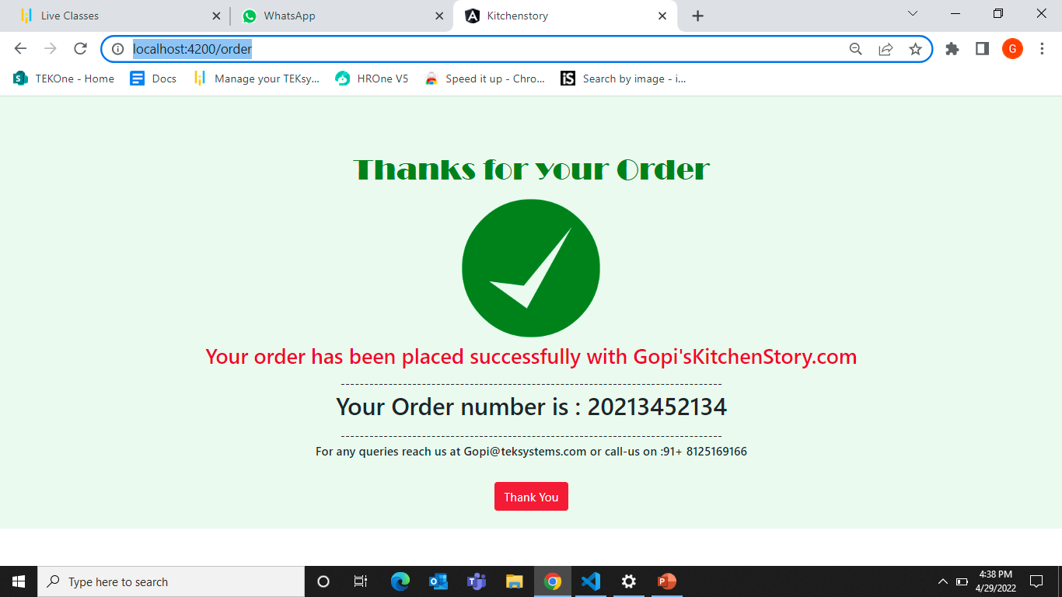
Order successful

Slide 12
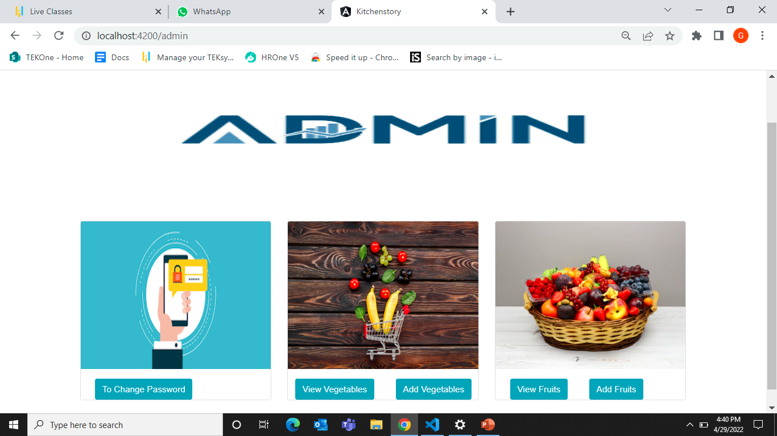
ADMIN

Slide 13
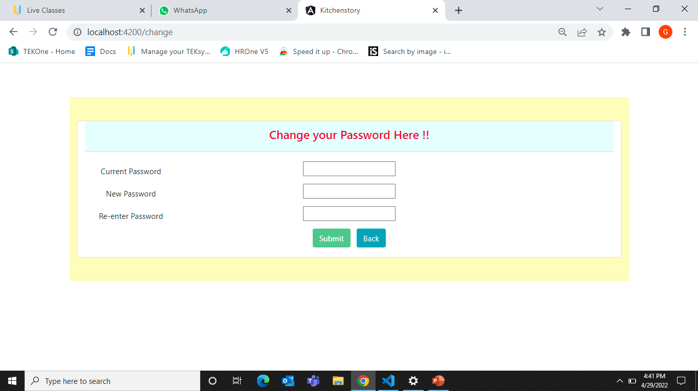
Change Password

Slide 14
Thank You

